Slide 1
Blueprint for Improving Instruction, Accessibility, and Outcomes for All Students
February 17th, 2015
Sacramento Convention Center

Slide 2
The Blueprint
2:30-4:00 Designing to Scale…Up
Closing
Notes:
Participants will reflect individually on this prompt.

Slide 3
Designing To Scale…UP!
Planning for Usability, Accessibility and Accommodations with Technology Beyond Students with Disabilities
An Aligned System of Supports Prototype-Individual Student Assessment Accessibility Profile (ISAAP)
Kevin Schaefer, Assistant Director of Special Programs/WestEd
Overview on Assistive Technology Supports
Jillian King, Administrator IV, Support Coordinator, SELPA at Placer County Office of Education
Notes:
Participants will reflect individually on this prompt.

Slide 4
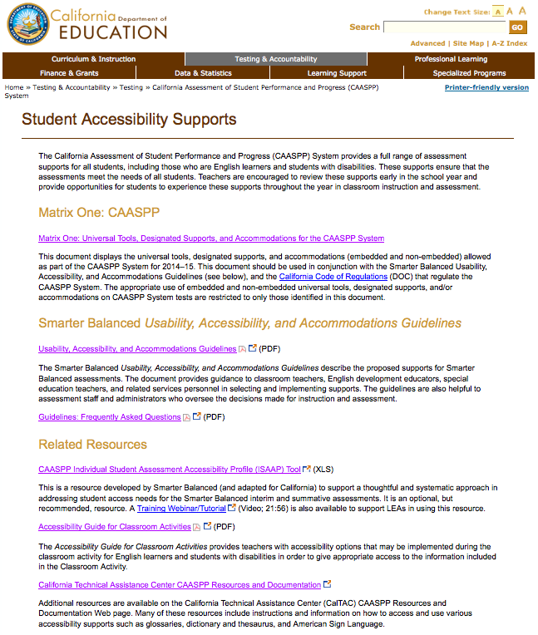
California Assessment of Student Performance and Progress (CAASPP) System Resources
http://www.cde.ca.gov/ta/tg/ca/accesssupport.asp
Notes:
Participants will reflect individually on this prompt.

Slide 5
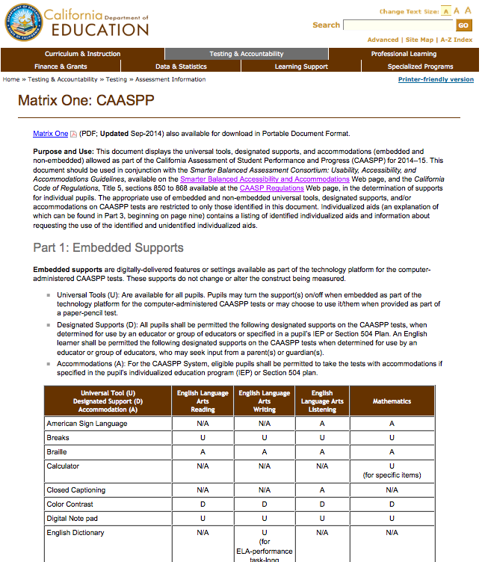
Matrix One
http://www.cde.ca.gov/ta/tg/ai/caasppmatrix1.asp
Notes:
Participants will reflect individually on this prompt.

Slide 6
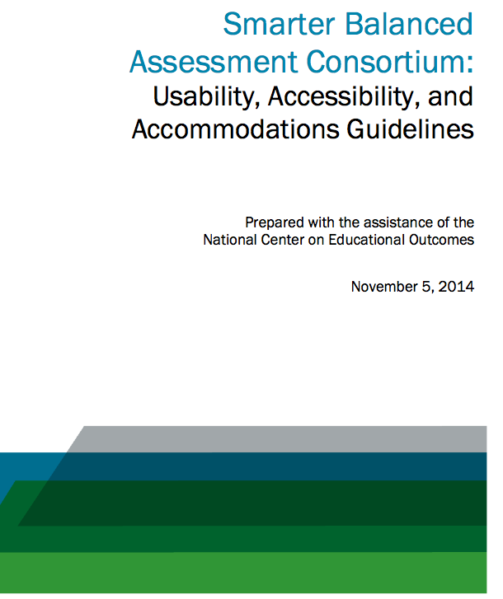
Usability, Accessibility, and Accommodations Guidelines
http://www.smarterbalanced.org/wordpress/wp-content/uploads/2014/08/SmarterBalanced_Guidelines.pdf
Notes:
Participants will reflect individually on this prompt.

Slide 7
Usability, Accessibility, and Accommodations Guidelines
Notes:
Participants will reflect individually on this prompt.

Slide 8
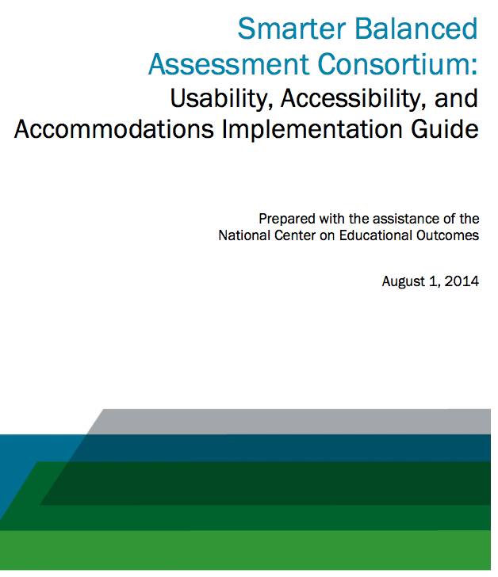
Usability, Accessibility, and Accommodations Implementation Guide
http://www.smarterbalanced.org/wordpress/wp-content/uploads/2014/03/Usability-Accessibility-and-Accommodations-Implementation-Guide.pdf
Notes:
Participants will reflect individually on this prompt.

Slide 9
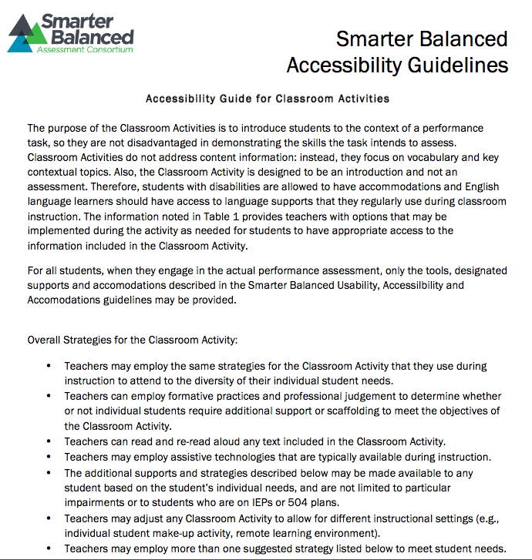
Classroom Activities
http://sbac.portal.airast.org/wp-content/uploads/2014/03/Accessibility-Guide-for-Classroom-Activities-Final.pdf
Notes:
Participants will reflect individually on this prompt.

Slide 10
Classroom Activities
The Classroom Activity is designed to be an introduction and not an assessment. All students may be provided instructional supports, scaffolding and/or accommodations used during regular instruction.
Notes:
Participants will reflect individually on this prompt.

Slide 11
Individual Student Assessment Accessibility Profile
http://www.cde.ca.gov/ta/tg/ca/accesssupport.asp

Slide 12
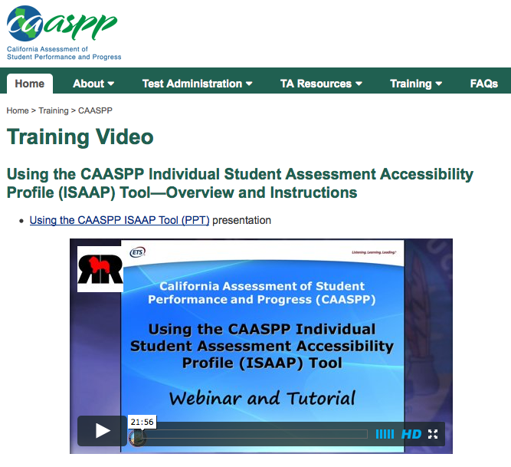
Individual Student Assessment Accessibility Profile
http://californiatac.org/rsc/videos/archived-webcast_ISAAP-overview-and-instructions.html
https://www.smarterbalancedlibrary.org/content/introduction-individual-student-assessment-accessibility-profile?key=2261a6f6a11089da1a0f15d17ca93789

Slide 13
Seven Step CAASPP ISAAP Process (Handout)
Step 1. Select key staff members who will be
involved in any of these seven steps and define their specific roles.
Step 2. Provide information and training to staff according to their role; provide information to parents; and provide information and training to students as appropriate.
Step 3. Identify students who may benefit from
designated supports (including students with an individualized education program (IEP) and Section 504 Plan, English learners, and English learners with disabilities.

Slide 14
Seven Step CAASPP ISAAP Process cont’d (Handout)
Step 4. Select the appropriate designated supports and accommodations for each students. The
CAASPP ISAAP Tool can be used to match student need to available supports.
Step 5. Enter designated supports and accommodations into the Test Ordering and Management System (TOMS).
Step 6. Perform a pre-administration check of assigned access supports to verify they are correct.
Step 7. Check for delivery of the assigned designated supports and accommodations at the time of the test.

Slide 15
Implementing the ISAAP Tool in a MTSS Framework Step 1
Select key staff members who will be involved in any of these seven steps and define their specific roles.
General education/Intervention teacher knowledge of Universal Tools,
Designated Supports, and Accommodations, the referral/documentation
process.
Special education teachers and support staff/504 Coordinators
supporting general education implementation/communicating of the
Universal Tools, Designated Supports, and Accommodations across all
environments as noted in students IEPs.
District Office staff providing aligned professional development
Testing Coordinator knowledge of the entire process from identification
to configuration in TOMS to assurance individual access needs are
accurate.
Other…

Slide 16
Implementing the ISAAP Tool in a MTSS Framework Step 2
Provide information and training to staff according to their role; provide information to parents; and provide information and training to students as appropriate.
Mode of communication to notify all staff and
stakeholders.
Aligned and comprehensive professional
development plan.
Frequent notifications throughout the year for use at
student study team (SST), IEP, 504 meetings.
Comparing old to new supports and decision-
making.
Timeline and communication plan for delivery of information.
Other…

Slide 17
Implementing the ISAAP Tool in a MTSS Framework Step 3
Identify students who may benefit from designated supports (including students with an IEP and Section 504 Plan, English learners, and English learners with disabilities.
The documentation process for identified students
noting that SST, IEP, and 504 Plan meetings are
occurring year round.
Correlation/documentation of instructional supports
and designated supports.
Other…

Slide 18
Implementing the ISAAP Tool in a MTSS Framework Step 4
Select the appropriate designated supports and accommodations for each student. The
CAASPP ISAAP Tool can be used to match student need to available supports.
Using input from IEP team (assessment, present levels of
performance, needs, goals, i.e., under what conditions,
accommodations), designated supports and
accommodations are in alignment.
504 Plan accommodations are implemented and
documented.
Supports are used and found successful in the classroom
instructional setting.
Other…

Slide 19
Implementing the ISAAP Tool in a MTSS Framework Step 5
Enter designated supports and accommodations into the Test Ordering and Management System (TOMS).
Identify who, how, when, where.
Provide training to key individuals.
Communicate process to staff and stakeholders.
Build capacity as knowledge isn’t stored with one
person.
Other…

Slide 20
Implementing the ISAAP Tool in a MTSS Framework Step 6
Perform a pre-administration check of assigned access supports to verify they are correct.
Identify who, how, when, where.
Provide training to key individuals.
Communicate process to staff and stakeholders.
A process for checks and balances for accuracy is
developed.
Build capacity as knowledge isn’t stored with one
person.
Other…

Slide 21
Implementing the ISAAP Tool in a MTSS Framework Step 7
Check for delivery of the assigned designated supports and accommodations at the time of the test.
Identify who, how, when, where.
Provide training to key individuals.
Communicate process to staff and stakeholders.
A process for checks and balances for accuracy is
developed.
Build capacity as knowledge isn’t stored with one
person.
Other…

Slide 22
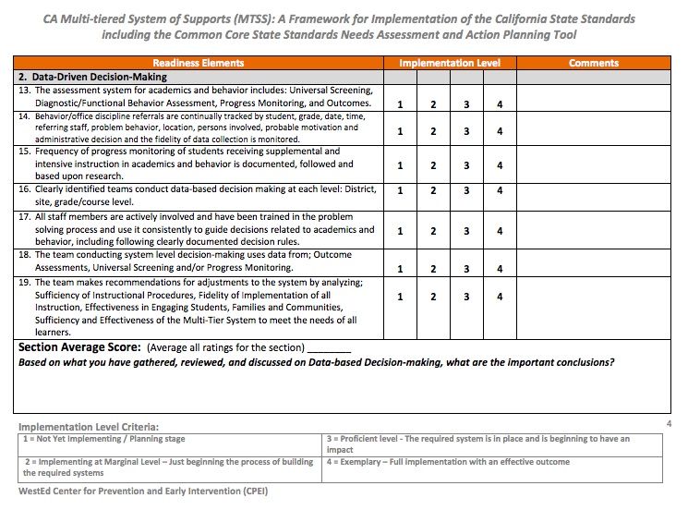
Data-Driven Decision-Making

Slide 23
Designing to scale…Up An example… moving towards a Regional model to more effectively embed Universal Design for learning and Assistive technology into Instruction and assessment
Jillian King, M.A., CCC-SLP
Coordinator, Placer County SELPA
Advisor, Placer County Office of Education Assistive Technology Program
Member, Assistive Technology Consortium - UC Davis Center for Excellence in Developmental Disabilities
February 17, 2015

Slide 24
This is a time of transformational change in the way teachers teach, students learn, and how we measure progress and achievement.
With the rollout of the CCSS and new statewide assessments, designed to include ALL learners, the opportunity to support inclusive learning environments has never been greater.
One thing the field of universal design for learning (UDL) has taught us is that there is no such thing as the mythical average learner. Many students face barriers when educated in standardized and uniform ways.

Slide 25
If our goal is ONE educational system for ALL students…
Questions we’re exploring as a region…
When do we start thinking about and planning for universal tools, designated supports and accommodations?
How do we streamline the same processes to support all learners (e.g. gifted and talented, struggling learners, English Language learners, students with disabilities)?
How do we approach this as an authentic partnership between general and special education?
How do we integrate the practices and resources developed on the special education side of the equation (e.g. assistive technology supports and services) with the principles of UDL to create a system that represents an effective Multitiered System of Supports?
How do we build the capacity to support all students?

Slide 26
Planning for Universal Tools, Designated Supports and Accommodations
Instruction
Classroom-based assessments
Statewide testing
How is our student doing? Our classroom? Our site? Our district?
A framework for planning for what universal tools, designated supports and accommodations are needed for all students to participate in Smarter Balanced, and to consider whether these are the same or similar to those used for instruction and classroom assessment.
ISAAP Tool

Slide 27
In heading towards a MTSS, we came from a different direction…our special education population
IDEA
504
ADA
We knew that students in OUR region, with disabilities, were not getting access to the assistive technology (AT) supports and services that they needed.
The range of service delivery models for supporting AT was broad…
‘No’ resources;
Single individual(s) assigned to the role of “AT Specialist” (with varying backgrounds and skill levels);
One example of a multidisciplinary team charged with specialized AT assessment and services to a region (Placer County).

Slide 28
Where did our discussion regarding AT lead us?
Regardless of the models currently operating that we looked at, AT services are “one student at a time” (referral, assessment, IEP documentation of needs, supports and services) [time intensive, available to only a small subset of students who might need or benefit]
Even if we focused on expanding training for special education staff to develop as “AT Specialists”, that wasn’t really going to solve the problem.
AT service delivery models are not scalable to meet even the needs of all students with disabilities (e.g. in Placer County SELPA we have approximately 7,300 students with disabilities; with a caseload of 250 students we would need 29 AT Specialists to support all potential students who could benefit; we currently have 2 full-time AT Specialists).

Slide 29
Who are we serving?
Students with low incidence disabilities
Students with high incidence disabilities
ALL students
Maintain an “expert driven” model:
AT Specialists provide assessment & services because of the specialized nature and needs of students
Shift towards a “capacity building” model:
AT Specialists build and support the capacity of school or site teams, building on the framework of UDL, and access for all students to universal and designated supports
Modelled on the “High Incidence Assistive Technology Program” (HIAT),
Montgomery County Public Schools, Maryland

Slide 30
Why don’t “expert-driven” models work in general?
Lack of technology integration. It takes more than just good assessment and tool demonstration to make technology an everyday tool in the classroom.
This is not a natural outcome of a “one-student-at-a-time” system (where specialists typically work with the student until the student can manage his/her own technology).
What we know from educational models for technology integration is that technology must be merged with the real content of the real classroom, and teachers and learners must “own” the tools.
We also need to think “bigger” than technology simply enhancing how we teach or how students learn, to transforming how we do things or doing things that have not been done before.

Slide 31
SAMR Model for enhancing technology integration
Ruben R, Puentedura, Ph.D.
Assistive Technology
Enhancement
Transformation
Augmentation
Modification
Substitution
Technology allows for significant task redesign
Redefinition
Technology acts as a direct tool substitute, with no functional change
Technology acts as a direct tool substitute, with functional improvement
Technology allows for the creation of new tasks, previously unconceivable
Google platform utilized in the classroom as a
replacement for paper and pencil tasks
Read & Write for
Google Chrome
features utilized for
a struggling student,
e.g. word prediction,
highlighting tools
Students utilize
Google Docs to share
and collaborate on
projects
Class creates a
Blog to comment
and dialogue with
other students outside
of the region working
on the same unit.

Slide 32
What might a multitiered system of support look like to address the needs of ALL students?
AT assessment & services for low incidence or high need (e.g. AAC device users) students
AT
assessment
& services
Team-based consideration of designated supports
UDL in the classroom
Capacity building model, where AT staff support school or site staff or teams in identifying universal tools and
designated supports, and in
implementing in
instructional settings and
classroom assessments

Slide 33
What are some of the challenges to consider?
This MUST be a collaborative process between general and special education, yet most of our program development and training efforts focus on one or the other. This requires support from LEA (special education leadership, educational services or curriculum leadership, technology leadership, etc.) and site-level administration (e.g. principals, department leaders) in both building a model, budgeting and procuring resources, setting up and supporting staff development, and allocating time to site-based “UDL leaders”.
We have a wide range of knowledge of and experience/ability in implementing UDL for instructional planning across our teaching workforce. We also have a wide range of knowledge of and experience/ability in implementing AT across our special education workforce.
We have varied technology platforms being utilized in different LEAs and/or school sites.
We have LEAs who are focused on numerous initiatives (e.g. rolling out the CCSS…the content of the standards and the depth of knowledge components; school-wide positive behavior interventions and supports).

Slide 34
Some strategies to consider: # 1 – Identify the essential tools and supports
Customize a “UDL Toolkit” to enable each site UDL leader to develop a working knowledge of and to quickly define the resources needed to meet the needs of the majority of students at that site (high incidence special education students, English Language learners, struggling learners).
Narrow the “areas of need” (e.g. reading, writing, speaking and listening, math, executive function) that align with implementation of the Common Core State Standards. The field of AT as a whole is more broad with supports encompassing needs across a wider spectrum. We don’t expect our site UDL leaders to have a broad knowledge of all areas and all tools like an AT Specialist would need.
Identify the essential tools and supports across only platforms that are available at the school site (e.g. non-tech, iOs built in, Windows/Microsoft built in, web/cloud-based, tablet, software, devices).

Slide 35
# 2 – Combine resources, planning, training and coaching into the model
Resources to consider include the UDL Toolkit along with Quick Guides and Videos for training staff (many are already readily available across the internet) for each tool or strategy prioritized for the site (in our model these will be developed and updated by AT Specialist staff, and will be available on a website available to the site UDL leaders). [go to the HIAT site for a great example!]
Ensure that each site has the opportunity to develop an implementation plan specific for that site. Some things to consider might include:
what type of general UDL training will the site UDL leader provide to all teachers across the year?
how will teachers access additional coaching or support?
how/when will staff complete the UDA planning process (e.g. using the ISAAP tool) for students in anticipation of Smarter Balanced assessments?
how will teachers identify and refer specific students for more in-depth consideration of designated supports?
how will site UDL leaders provide training [using the Quick Guides and Videos provided] when a teacher will trial a strategy or tool?

Slide 36
Develop a training plan that scaffolds learning over a period of time, and allows for the acquisition of:
general knowledge (e.g. principles of UDL, which can be done with online learning modules when convenient for staff;
understanding of the tools and strategies available in the UDL toolkit and how to select strategies and tools to align with areas of need;
how to facilitate a team-based consideration process;
how to document for the 504 plan and/or IEP when the student has a disability)
and includes ongoing practice and coaching in the roles and responsibilities of the site UDL leader.

Slide 37
Some final thoughts…
Both the Common Core State Standards and the Smarter Balanced assessments ensure ACCESS for all students.
We know we can only guarantee that if we’ve built it into good instruction from the start.
We know that UDL is the framework that is critical to making that happen, and is embedded into the standards.
We know that for some students more specific supports and accommodations (including AT) will be needed.
We know, anecdotally, that these important elements are not always at the forefront of (or even included in) planning, training and implementation of these changes.
We have a unique opportunity here to design our systems and supports to include ALL students and improve outcomes across our traditionally struggling learners.

Slide 38
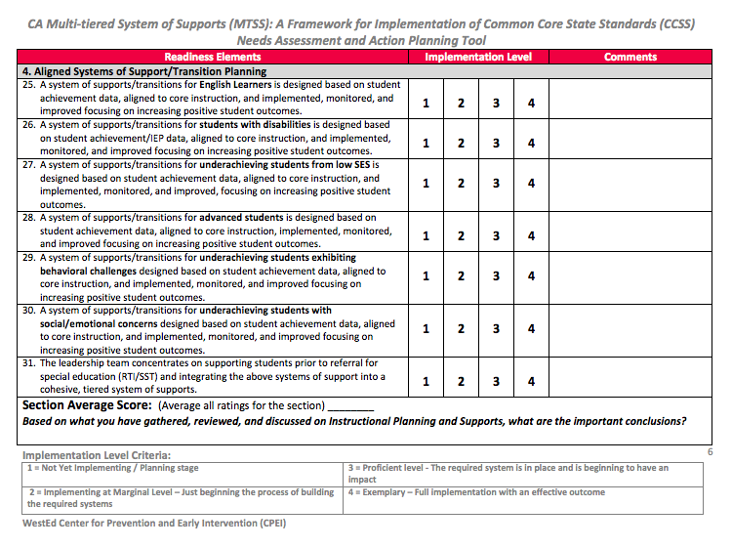
Designing to Scale…Up!

Slide 39
Built for Lasting Effect…
All students should have an equal
opportunity to learn and excel in a safe and supportive environment. Because inequities at all levels of education still exist, educational equity is the civil rights issue of our generation.
The United States Department of Education’s Strategic Plan for Fiscal
Years 2011-2014
- The California ELA/ELD Frameworks pgs. 2-3

